Slide 1
Critical systems development

Slide 2
Objectives
To explain how fault tolerance and fault avoidance contribute to the development of dependable systems
To describe characteristics of dependable software processes
To introduce programming techniques for fault avoidance
To describe fault tolerance mechanisms and their use of diversity and redundancy

Slide 3
Topics covered
Dependable processes
Dependable programming
Fault tolerance
Fault tolerant architectures

Slide 4
Software dependability
In general, software customers expect all software to be dependable. However, for non-critical applications, they may be willing to accept some system failures.
Some applications, however, have very high dependability requirements and special software engineering techniques may be used to achieve this.

Slide 5
Dependability achievement
Fault avoidance
  The system is developed in such a way that human error is avoided and thus system faults are minimised.
  The development process is organised so that faults in the system are detected and repaired before delivery to the customer.
Fault detection
  Verification and validation techniques are used to discover and remove faults in a system before it is deployed.
Fault tolerance
  The system is designed so that faults in the delivered software do not result in system failure.

Slide 6
Diversity and redundancy
Redundancy
  Keep more than 1 version of a critical component available so that if one fails then a backup is available.
Diversity
  Provide the same functionality in different ways so that they will not fail in the same way.
However, adding diversity and redundancy adds complexity and this can increase the chances of error.
Some engineers advocate simplicity and extensive V & V is a more effective route to software dependability.

Slide 7
Diversity and redundancy examples
Redundancy. Where availability is critical (e.g. in e-commerce systems), companies normally keep backup servers and switch to these automatically if failure occurs.
Diversity. To provide resilience against external attacks, different servers may be implemented using different operating systems (e.g. Windows and Linux)

Slide 8
Fault-free software
Current methods of software engineering now
allow for the production of fault-free software, at least for relatively small systems.
Fault-free software means software which
conforms to its specification. It does NOT mean
software which will always perform correctly as
there may be specification errors.
The cost of producing fault free software is very
high. It is only cost-effective in exceptional
situations. It is often cheaper to accept software faults and pay for their consequences than to expend resources on developing fault-free software.

Slide 9
Fault-free software development
Dependable software processes
Quality management
Formal specification
Static verification
Strong typing
Safe programming
Protected information

Slide 10
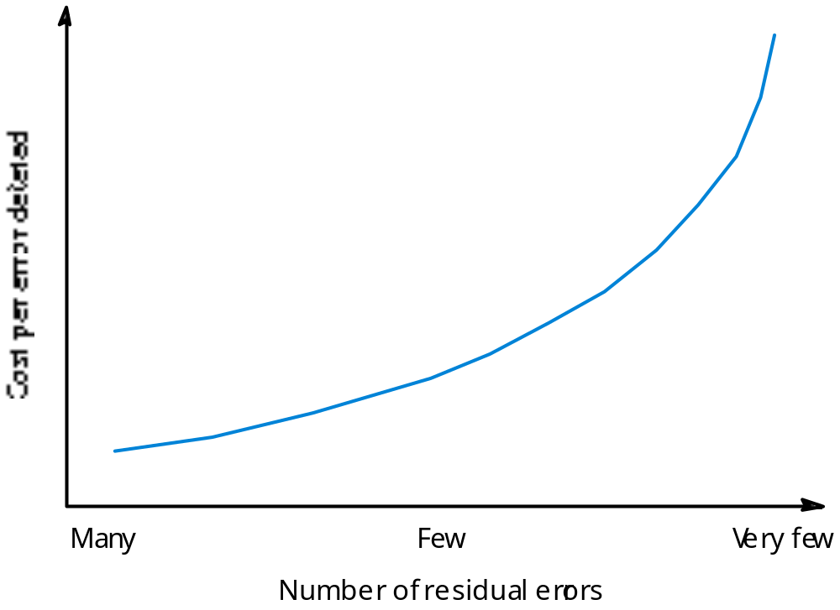
Fault removal costs
a

Slide 11
Dependable processes
To ensure a minimal number of software faults, it is important to have a well-defined, repeatable software process.
A well-defined repeatable process is one that does not depend entirely on individual skills; rather can be enacted by different people.
For fault detection, it is clear that the process activities should include significant effort devoted to verification and validation.

Slide 12
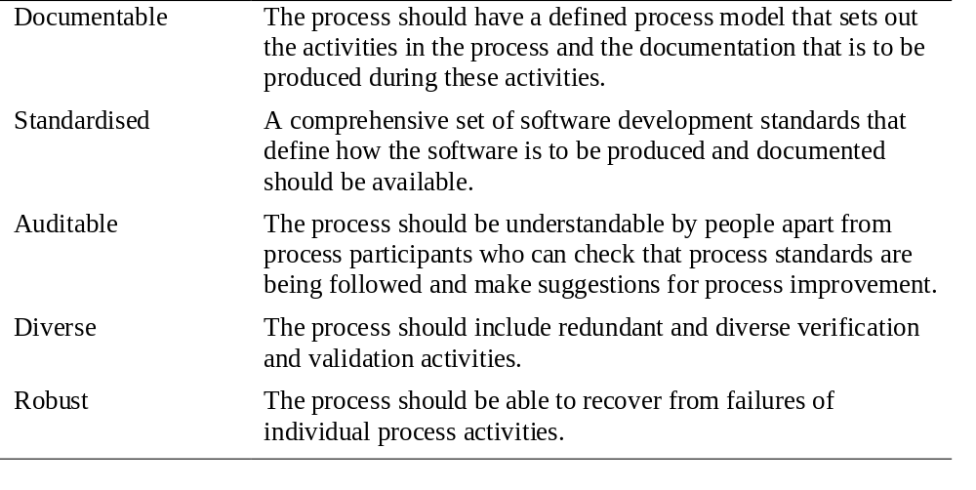
Dependable process characteristics

Slide 13
Validation activities
Requirements inspections.
Requirements management.
Model checking.
Design and code inspection.
Static analysis.
Test planning and management.
Configuration management, discussed in Chapter 29, is also essential.

Slide 14
Dependable programming
Use programming constructs and techniques that contribute to fault avoidance and fault tolerance
  Design for simplicity;
  Protect information from unauthorised access;
  Minimise the use of unsafe programming constructs.

Slide 15
Information protection
Information should only be exposed to those parts of the program which need to access it. This involves the creation of objects or abstract data types that maintain state and that provide operations on that state.
This avoids faults for three reasons:
  the probability of accidental corruption of information is reduced;
  the information is surrounded by ‘firewalls’ so that problems are less likely to spread to other parts of the program;
  as all information is localised, you are less likely to make errors and reviewers are more likely to find errors.

Slide 16
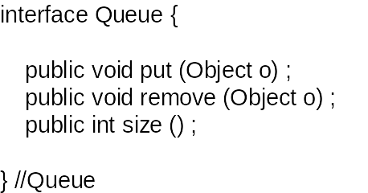
A queue specification in Java

Slide 17
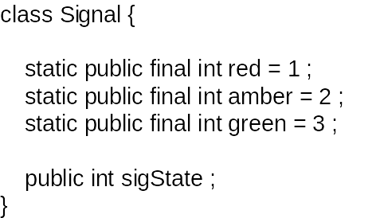
Signal declaration in Java

Slide 18
Safe programming
Faults in programs are usually a consequence of programmers making mistakes.
These mistakes occur because people lose track of the relationships between program variables.
Some programming constructs are more error-prone than others so avoiding their use reduces programmer mistakes.

Slide 19
Structured programming
First proposed in 1968 as an approach to development that makes programs easier to understand and that avoids programmer errors.
Programming without gotos.
While loops and if statements as the only
control statements.
Top-down design.
An important development because it promoted thought and discussion about programming.

Slide 20
Error-prone constructs
Floating-point numbers
  Inherently imprecise. The imprecision may lead to invalid
  comparisons.
Pointers
  Pointers referring to the wrong memory areas can corrupt
  data. Aliasing can make programs difficult to understand
  and change.
Dynamic memory allocation
  Run-time allocation can cause memory overflow.
Parallelism
  Can result in subtle timing errors because of unforeseen
  interaction between parallel processes.
Recursion
  Errors in recursion can cause memory overflow.

Slide 21
Error-prone constructs
Interrupts
  Interrupts can cause a critical operation to be terminated
  and make a program difficult to understand.
Inheritance
  Code is not localised. This can result in unexpected behaviour when changes are made and problems of understanding.
Aliasing
  Using more than 1 name to refer to the same state variable.
Unbounded arrays
  Buffer overflow failures can occur if no bound checking on arrays.
Default input processing
  An input action that occurs irrespective of the input.

Slide 22
Exception handling
A program exception is an error or some
unexpected event such as a power failure.
Exception handling constructs allow for such
events to be handled without the need for
continual status checking to detect exceptions.
Using normal control constructs to detect
exceptions needs many additional statements to be
added to the program. This adds a significant
overhead and is potentially error-prone.

Slide 23
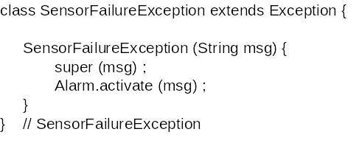
Exceptions in Java 1

Slide 24
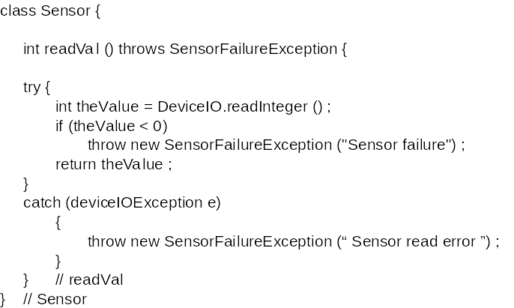
Exceptions in Java 2

Slide 25
A temperature controller
Exceptions can be used as a normal programming technique and not just as a way of recovering from faults.
Consider an example of a freezer controller that keeps the freezer temperature within a specified range.
Switches a refrigerant pump on and off.
Sets off an alarm is the maximum allowed temperature is exceeded.
Uses exceptions as a normal programming technique.

Slide 26
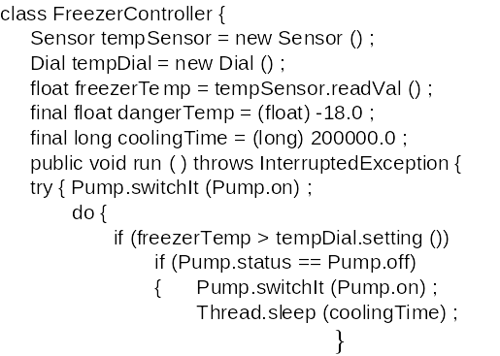
Freezer controller 1

Slide 27
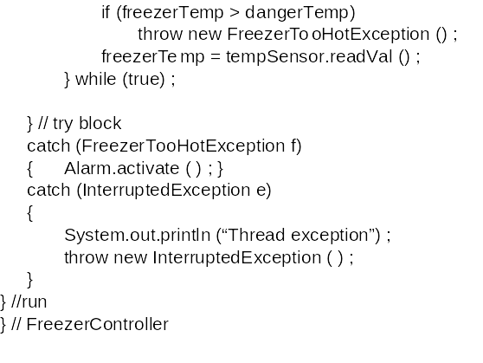
Freezer controller 2

Slide 28
Fault tolerance
In critical situations, software systems must be
fault tolerant.
Fault tolerance is required where there are high availability requirements or where system failure costs are very high.
Fault tolerance means that the system can continue in operation in spite of software failure.
Even if the system has been proved to conform to its specification, it must also be fault tolerant as there may be specification errors or the validation may be incorrect.

Slide 29
Fault tolerance actions
Fault detection
  The system must detect that a fault (an incorrect system state) has occurred.
Damage assessment
  The parts of the system state affected by the fault must be
  detected.
Fault recovery
  The system must restore its state to a known safe state.
Fault repair
  The system may be modified to prevent recurrence of the
  fault. As many software faults are transitory, this is often
  unnecessary.

Slide 30
Fault detection and damage assessment
The first stage of fault tolerance is to detect that a fault (an erroneous system state) has occurred or will occur.
Fault detection involves defining constraints that must hold for all legal states and checking the state against these constraints.

Slide 31
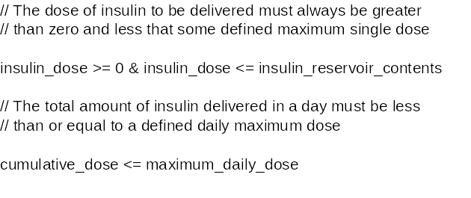
Insulin pump state constraints

Slide 32
Fault detection
Preventative fault detection
  The fault detection mechanism is initiated before the state change is committed. If an erroneous state is detected, the change is not made.
Retrospective fault detection
  The fault detection mechanism is initiated after the system state has been changed. This is used when a incorrect sequence of correct actions leads to an erroneous state or when preventative fault detection involves too much overhead.

Slide 33
Type system extension
Preventative fault detection really involves extending the type system by including additional constraints as part of the type definition.
These constraints are implemented by defining basic operations within a class definition.

Slide 34
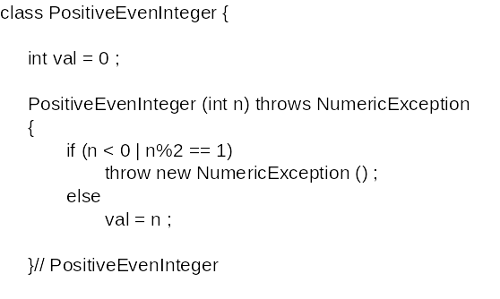
PositiveEvenInteger 1

Slide 35
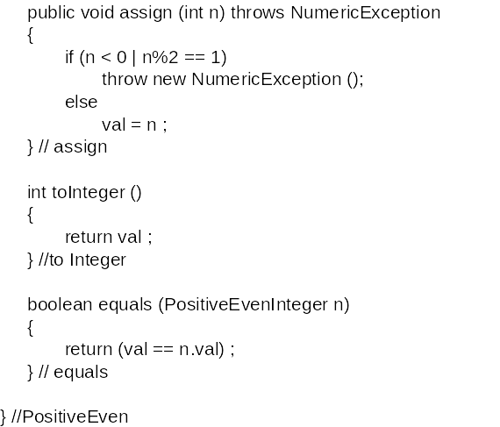
PositiveEvenInteger 2

Slide 36
Damage assessment
Analyse system state to judge the extent of corruption caused by a system failure.
The assessment must check what parts of the state space have been affected by the failure.
Generally based on ‘validity functions’ that can be applied to the state elements to assess if their value is within an allowed range.

Slide 37
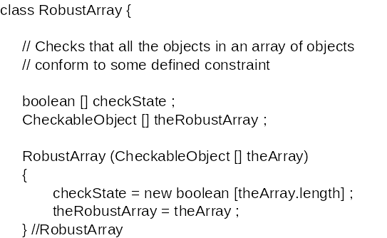
Robust array 1

Slide 38
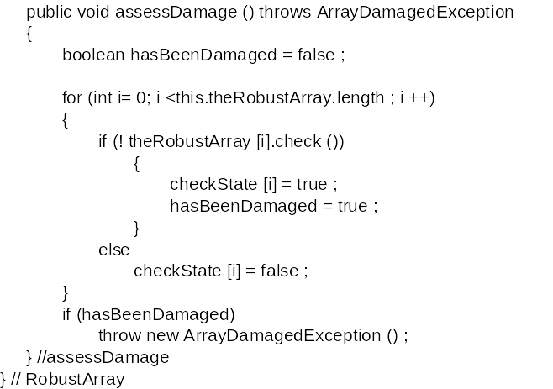
Robust array 2

Slide 39
Damage assessment techniques
Checksums are used for damage assessment in data transmission.
Redundant pointers can be used to check the integrity of data structures.
Watch dog timers can check for non-terminating processes. If no response after a certain time, a problem is assumed.

Slide 40
Fault recovery and repair
Forward recovery
  Apply repairs to a corrupted system state.
Backward recovery
  Restore the system state to a known safe state.
Forward recovery is usually application specific
- domain knowledge is required to compute
possible state corrections.
Backward error recovery is simpler. Details of a
safe state are maintained and this replaces the
corrupted system state.

Slide 41
Forward recovery
Corruption of data coding
  Error coding techniques which add redundancy to coded
  data can be used for repairing data corrupted during
  transmission.
Redundant pointers
  When redundant pointers are included in data structures
  (e.g. two-way lists), a corrupted list or filestore may be
  rebuilt if a sufficient number of pointers are uncorrupted
  Often used for database and file system repair.

Slide 42
Backward recovery
Transactions are a frequently used method of backward recovery. Changes are not applied until computation is complete. If an error occurs, the system is left in the state preceding the transaction.
Periodic checkpoints allow system to 'roll-back' to a correct state.

Slide 43
Safe sort procedure
A sort operation monitors its own execution and assesses if the sort has been correctly executed.
It maintains a copy of its input so that if an error occurs, the input is not corrupted.
Based on identifying and handling exceptions.
Possible in this case as the condition for a‘valid’ sort is known. However, in many cases it is difficult to write validity checks.

Slide 44
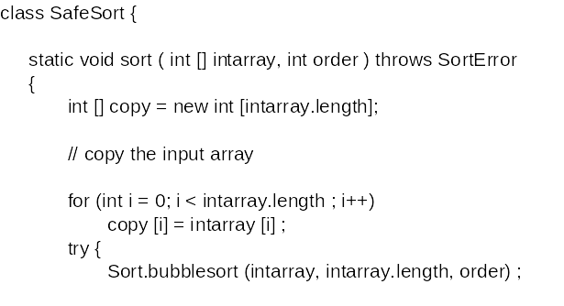
Safe sort 1

Slide 45
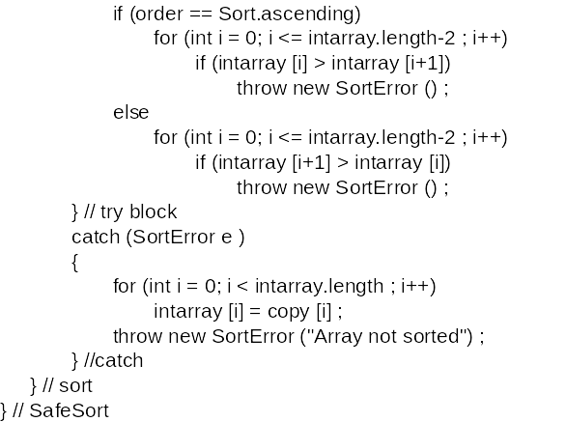
Safe sort 2

Slide 46
Fault tolerant architecture
Defensive programming cannot cope with faults that involve interactions between the hardware and the software.
Misunderstandings of the requirements may mean that checks and the associated code are incorrect.
Where systems have high availability requirements, a specific architecture designed to support fault tolerance may be required.
This must tolerate both hardware and software failure.

Slide 47
Hardware fault tolerance
Depends on triple-modular redundancy (TMR).
There are three replicated identical components that receive the same input and whose outputs are compared.
If one output is different, it is ignored and component failure is assumed.
Based on most faults resulting from component failures rather than design faults and a low probability of simultaneous component failure.

Slide 48
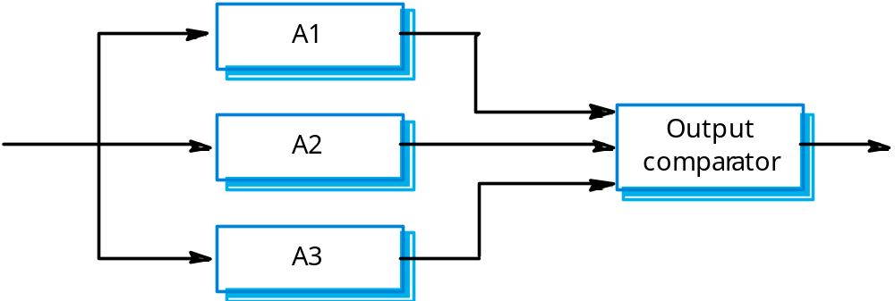
Hardware reliability with TMR

Slide 49
Output selection
The output comparator is a (relatively) simple hardware unit.
It compares its input signals and, if one is different from the others, it rejects it. Essentially, the selection of the actual output depends on the majority vote.
The output comparator is connected to a fault management unit that can either try to repair the faulty unit or take it out of service.

Slide 50
Fault tolerant software architectures
The success of TMR at providing fault tolerance is based on two fundamental assumptions
  The hardware components do not include common design faults;
  Components fail randomly and there is a low probability of simultaneous component failure.
Neither of these assumptions are true for software
  It isn’t possible simply to replicate the same component as they would have common design faults;
  Simultaneous component failure is therefore virtually inevitable.
Software systems must therefore be diverse.

Slide 51
Design diversity
Different versions of the system are designed and implemented in different ways. They therefore ought to have different failure modes.
Different approaches to design (e.g object-oriented and function oriented)
  Implementation in different programming languages;
  Use of different tools and development environments;
  Use of different algorithms in the implementation.

Slide 52
Software analogies to TMR
N-version programming
  The same specification is implemented in a number of
  different versions by different teams. All versions compute simultaneously and the majority output is selected using a voting system.
  This is the most commonly used approach e.g. in many models of the Airbus commercial aircraft.
Recovery blocks
  A number of explicitly different versions of the same specification are written and executed in sequence.
  An acceptance test is used to select the output to be transmitted.

Slide 53
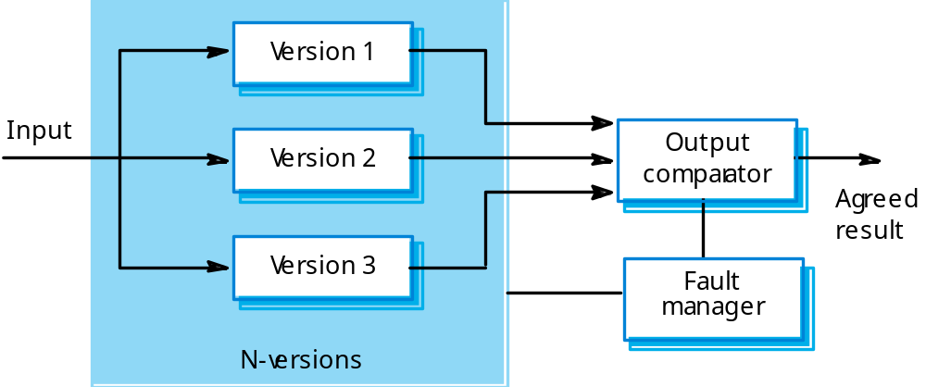
N-version programming

Slide 54
Output comparison
As in hardware systems, the output comparator is a simple piece of software that uses a voting mechanism to select the output.
In real-time systems, there may be a requirement that the results from the different versions are all produced within a certain time frame.

Slide 55
N-version programming
The different system versions are designed and implemented by different teams. It is assumed that there is a low probability that they will make the same mistakes. The algorithms used should but may not be different.
There is some empirical evidence that teams commonly misinterpret specifications in the same way and chose the same algorithms in their systems.

Slide 56
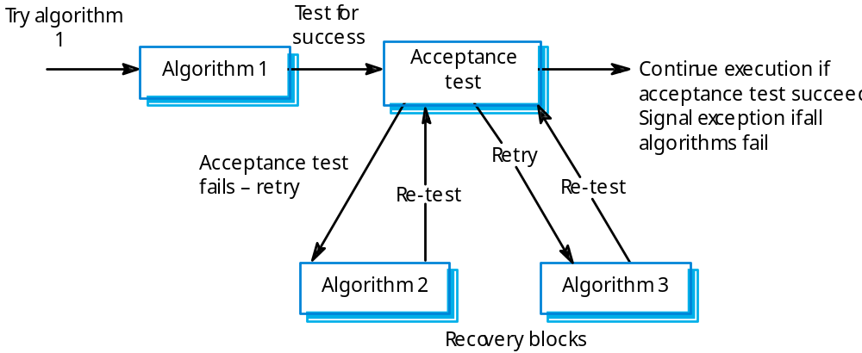
Recovery blocks

Slide 57
Recovery blocks
These force a different algorithm to be used for each version so they reduce the probability of common errors.
However, the design of the acceptance test is difficult as it must be independent of the computation used.
There are problems with this approach for real-time systems because of the sequential operation of the redundant versions.

Slide 58
Problems with design diversity
Teams are not culturally diverse so they tend to tackle problems in the same way.
Characteristic errors
  Different teams make the same mistakes. Some parts of an implementation are more difficult than others so all teams tend to make mistakes in the same place;
  Specification errors;
  If there is an error in the specification then this is reflected in all implementations;
  This can be addressed to some extent by using multiple specification representations.

Slide 59
Specification dependency
Both approaches to software redundancy are susceptible to specification errors. If the specification is incorrect, the system could fail
This is also a problem with hardware but software specifications are usually more complex than hardware specifications and harder to validate.
This has been addressed in some cases by developing separate software specifications from the same user specification.

Slide 60
Key points
Dependability in a system can be achieved through fault avoidance, fault detection and fault tolerance.
The use of redundancy and diversity is essential to the development of dependable systems.
The use of a well-defined repeatable process is important if faults in a system are to be minimised.
Some programming constructs are inherently error-prone - their use should be avoided wherever possible.

Slide 61
Key points
Exceptions are used to support error management in dependable systems.
The four aspects of program fault tolerance are failure detection, damage assessment, fault recovery and fault repair.
N-version programming and recovery blocks are alternative approaches to fault-tolerant architectures.

